Slide 1
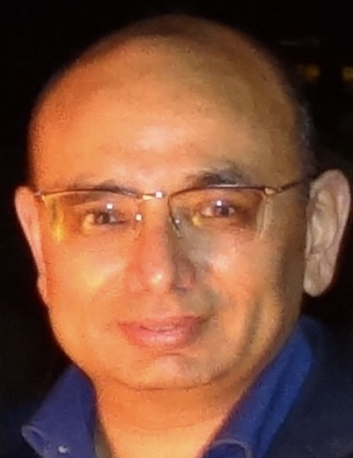
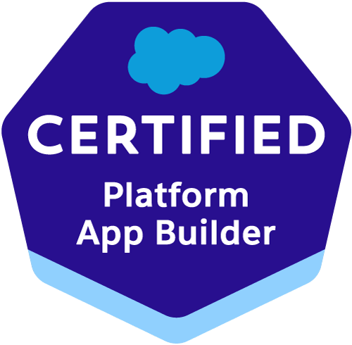

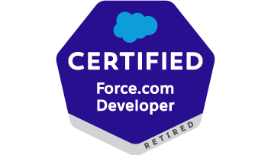
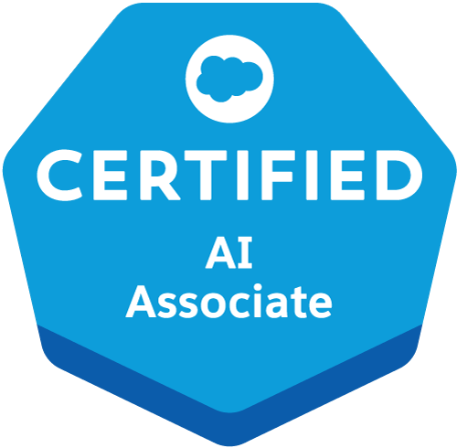
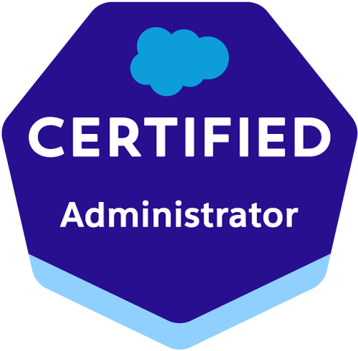
Vixit Bhardwaj – Technical Program Manager
5 x Salesforce Certified
Relevant Experience
Program Manager for a leading Energy Client
Led end-to-end delivery of multiphase salesforce transformation program
Set governance framework (release calendars, change approval process, DevOps standards, cross team communication channels etc.)
Designed and developed the data model and end-to-end architecture ensuring that the data flows seamlessly between the related systems.
Designed and developed a Knowledge Base in the service cloud for community users which encompasses Trending Articles, Featured Topics and Favorite Articles, Configuring Experience Cloud, creating custom Lightning web components, designing user interfaces and integrating with external systems using the MuleSoft API’s
Oversaw full lifecycle of data migration initiatives (mapping, cleansing and ETL validations) across multiple orgs, ensuring zero data loss and smooth business continuity
Responsible for of code review, Solution for Spaghetti Apex(duplicated and non-bulkified logics), optimize the existing configurations
Work closely with client partners, technology data vendors and cross functional teams to design, develop, adopt, and manage modernization programs of client architecture and data quality management.
Write complex queries and perform data analysis, analyze application issues or process failures
Analyze scope of work, Requirement gathering and working closely with onshore team and client.
Articulate business problems and participate in the development of conceptual and logical architecture
Identify all areas where improvement can be made ex: memory leakage, hard coding removal or coding standard were not followed.
Estimation for Jira stories and elaborate the stories on Jira.
Ensure on time delivery of modules as per committed timelines.
Expand all existing implementation including integration for new business and closely worked with other interface team to implement it.
Responsible for QA/UAT completion for all stories as per sprint plan and complete it on time along with issue resolution.
Managed program risks issues, dependencies and budgets, improving transparency through dashboards and communication plans for executives and steering committees
Profile Summary - TPM
Detail oriented Salesforce Technical Program Manager with extensive experience in leading enterprise scales programs across Sales Cloud, Service Cloud; Experience Cloud and Custom Lightning Solutions
Tracking overall PI progress across all products - Active and KLO
Monitoring POD-wise Sprint progress, velocity, identifying and resolving roadblocks
Participating in Partner business roadmap and review to identify the possible impact on A&C Products
Expertise includes integration strategy (REST / SOAP, MuleSoft) Data migration, security & compliance, DevOps and Salesforce best practices.
Working with Architects to translate complex business requirements to solutions
Client Stakeholder Management
On-shore and offshore coordination
Stakeholders' interaction & executive communication
Vendor and Resource Management
SPOC for Salesforce Technical team
Agile/Scrum Leadership
PMO Governance and Change control
Project Estimations and implementation Strategy
Overseeing output and progress of onshore and offshore work across PODs
Leading daily stand-up with internal Cognizant and POD-wise meetings
Identify and address Release Mgmt. DevOps issues
Managing attrition and backfill to maintain sprint velocity

